Slide 2
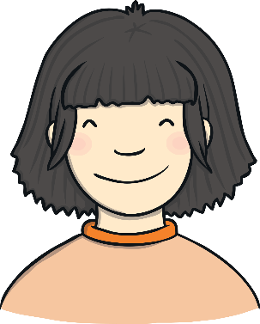
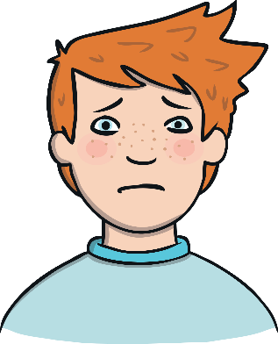
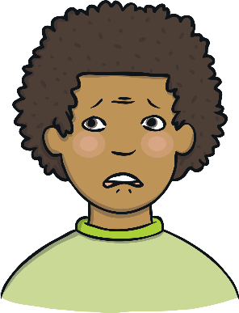
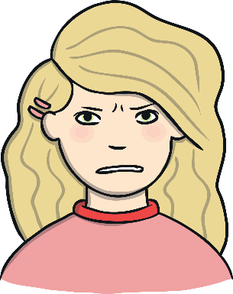
Feelings
How many different words can you think of that describe your feelings?
Have a go!
Tell your partner as many feeling words as you can think of.
Look at these feelings words:
happy
sad
lonely
scared
cross

Slide 3
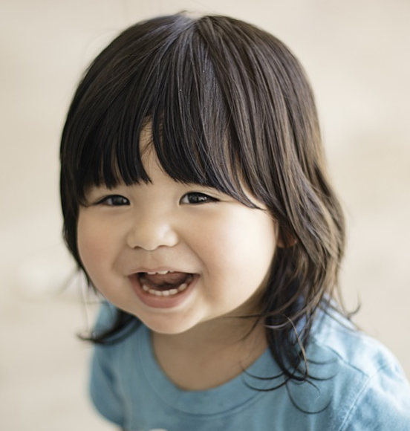
Feelings
Look at this child. How do you think she is feeling?
happy

Slide 4
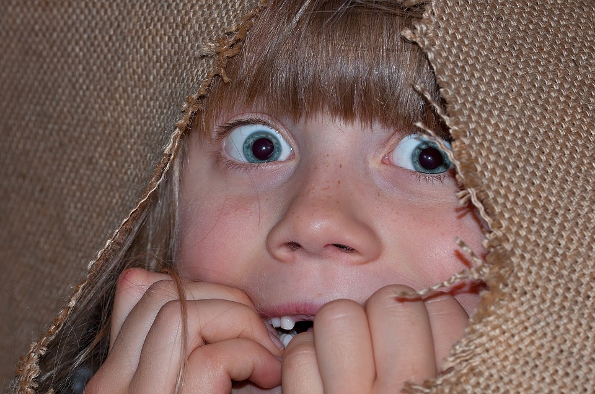
Feelings
Look at this child. How do you think she is feeling?
scared

Slide 5
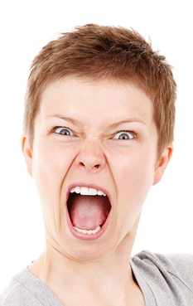
Feelings
Look at this person. How do you think she is feeling?
angry

Slide 6
How Can We Show Our Feelings?
Have a go!
Without saying any words, show your partner a feeling.
Can they guess which feeling you are showing?
happy
sad
lonely
scared
cross

Slide 7
Feeling Good and Bad
Some feelings make us feel good. Some feelings make us feel bad. Can you sort these feelings into the right place?
happy
sad
excited
lonely
scared
cross
Feeling Good | Feeling Bad

Slide 8
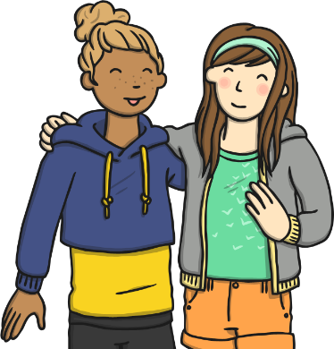
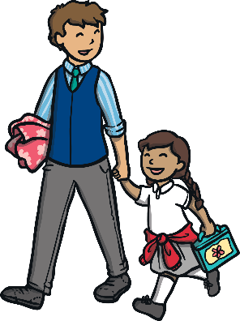
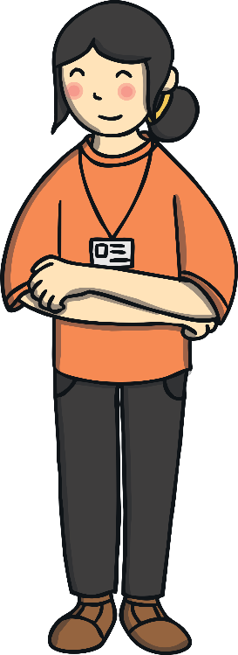
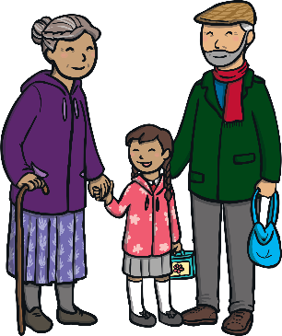
Who Can Help Us?
If we have feelings that make us feel bad, who can help us?
Always tell someone if you have feelings that make you feel bad.

