Slide 1
Noun Phrases
Describing
Nouns
Adverbs
Imagining
Adjectives
Being specific
Creating a picture

Slide 2
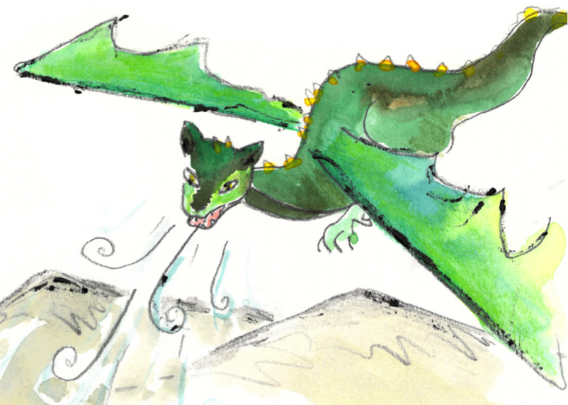
Nouns
A noun names a person, place, idea, thing or feeling.
In front of a noun, we often have one of ...
a
an
the
A dragon flew over a mountain.
A bird heard the sound of the dragon.
George had a feeling of excitement.

Slide 3
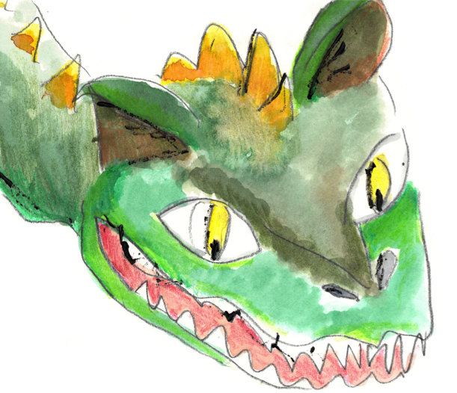
Adjectives
An adjective describes a noun.
Adjectives can come beside the noun
or they can complete a sentence.
The
fierce, green
dragon
breathes
fire.
The
dragon
seemed
scary but stupid.
You can have several adjectives together…
But then you need a comma.
The fierce, green dragon…

Slide 4
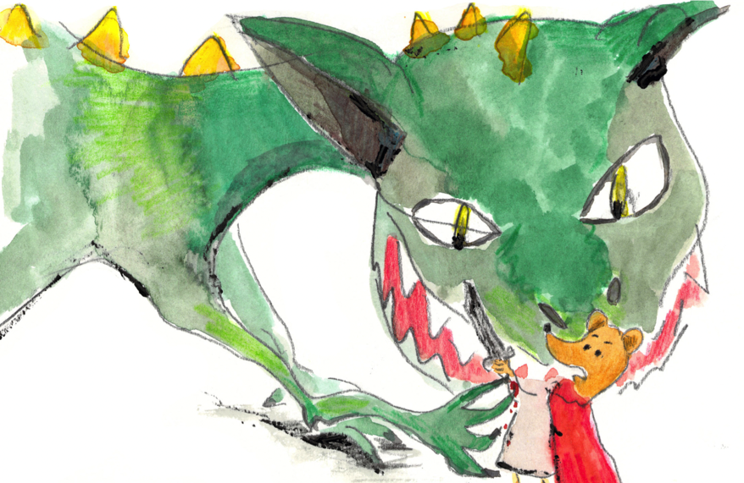
Adjectives
Adjectives describe nouns.
Adjectives can come beside the noun.
The dragon
What sort of dragon?
Adjectives can complete a sentence.
The huge, terrifying dragon
Go on…
The huge, terrifying dragon felt…
How did the dragon feel?
Can you spot the adjectives?
The huge, terrifying dragon felt puzzled.
The huge, terrifying dragon felt puzzled.

Slide 5
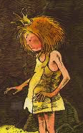
Adverbs
Adverbs add to adjectives – they tell us more about the description.
The silly dragon...
The smart princess …
How silly is the dragon?
How smart is the princess?
Now try it yourself!
We can choose an adverb.
extremely
very
unusually
really
exceptionally
quite
Now we can finish the sentence.
The really smart princess outwitted the dragon.
The extremely silly dragon tired himself out.

Slide 6
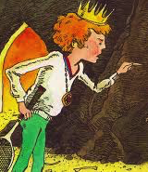
Using adverbs
Add an adverb to tell us more about each description.
A_______ stupid prince
An awfully
absolutely
An ________ horrid thing to say
quite
The ____ relieved princess
Hint!
Try your adverb out. Does it make sense?
An _________ unusual story ending
extremely

