Slide 1
Class 2 Meet the Teacher
2021-2022
Notes:
Hello and Welcome to Class 2 meet the teacher
I’m Mrs Bernard and I will be you child’s or children’s teacher this coming year.
The purpose of this meeting is to give you an opportunity to…
meet me
Learn about the expectations of class 2
Hear about what the children are going to be up to this year
and learn how you can help at home.

Slide 2
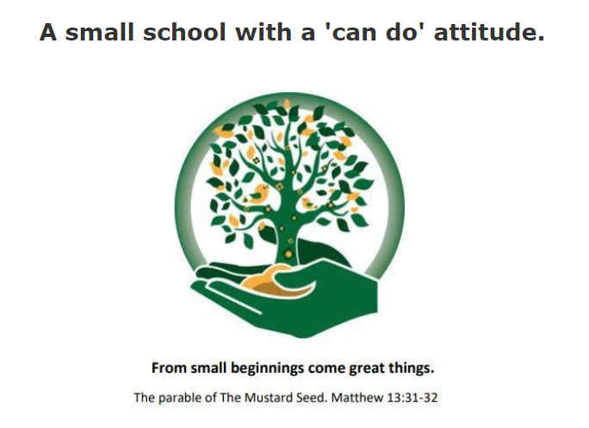
Notes:
Everything we do in Class 2 is based around our school vision
From small beginnings come great things
Which comes from the parable of the mustard seed. Mathew 13:31-32
Our vision is to provide a happy, safe and high quality education with Christian and British values.
Being a small school we can provide a balance of individualised learning combined with the pastoral and emotional needs children need to learn and grow.
We provide an exceptional, personalised journey that enables each child to flourish in our family and community and on into the future.

Slide 3
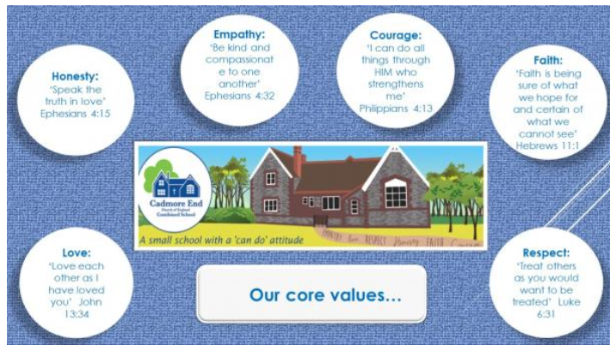
Notes:
Our core school values are…
Empathy
Courage
Faith
Respect
Honesty
And Love

Slide 4
The Class 2 Team
Mrs Bernard – Class Teacher
Miss Dani- Teaching Assistant
Mrs Maughn- Teaching Assistant
Mrs Caine- HLTA
Mrs Farrar- HLTA
Notes:
I will be teaching every morning supported by Miss Dani and Mrs Maughn.
Mrs Maughn will be with the class most afternoons to support Mrs Caine, Mrs Farrar or myself.

Slide 5
English The main focus for writing is sentence structure for Year 1 and extending sentences to make them more interesting in Year 2. This is taught through different genres of writing; stories, non-fiction and poetry.
Fiction 1: Stories in familiar settings Fiction 2: Fantasy Non-fiction Plan 1: Labels, lists, signs and posters | Non-fiction 2: Information texts Poetry 1: Silly poems Poetry 2: List poems | Fiction 1: Traditional tales Fiction 2: Stories about feelings Non-fiction 1: Instructions and lists | Non-fiction 2: Recounts Poetry 1: Bedtime poems Poetry 2: Poems with elements of fantasy and humour | Fiction 1: Traditional tales from other cultures Fiction 2: Humorous stories Non-fiction 1: Letters and books | Non-fiction 2: Information texts – owls Poetry 1: Poems to say out loud Poetry 2: A study of a poet - Milligan
Notes:
The main focus for writing is sentence structure for Year 1 and extending sentences to make them more interesting in Year 2. This is taught through different genres of writing; stories, non-fiction and poetry.
This table shows the genres taught in each half term.

Slide 6
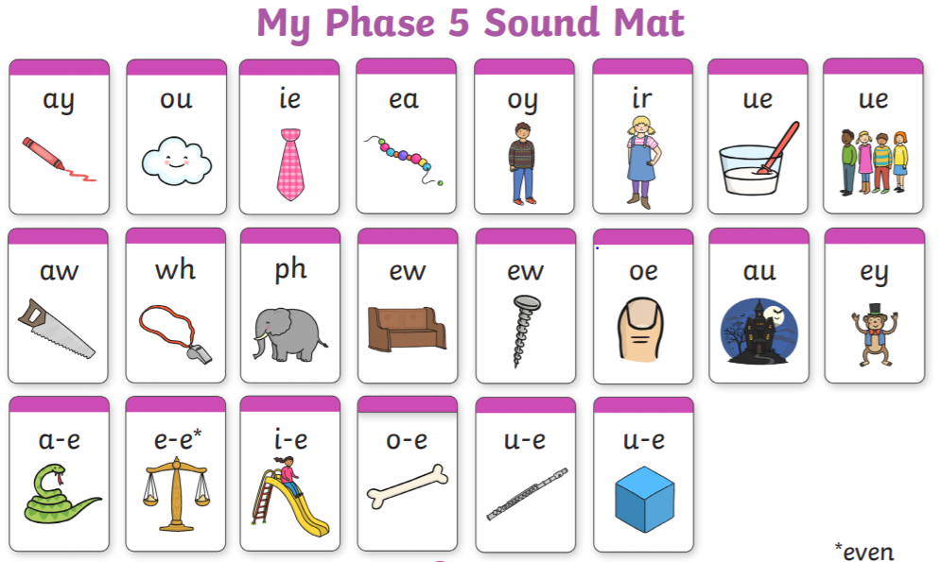
Phonics
Notes:
In Year 1 most children will start to learn Phase 5
We start introducing alternative spellings for sounds, like 'igh’. Children learn new graphemes (different ways of spelling each sound) and alternative pronunciations for these: for example, learning that the grapheme ‘ow’ makes a different sound in ‘snow’ and ‘cow’. They should become quicker at blending, and start to do it silently. They learn about split digraphs (the ‘magic e’) such as the a-e in ‘name.’ They’ll start to choose the right graphemes when spelling, and will learn more tricky words, including ‘people,’ ‘water’ and ‘friend’. They also learn one new phoneme: /zh/, as in ‘treasure.’ By the end of Year 1, children should be able to:
Say the sound for any grapheme they are shown
Write the common graphemes for any given sound (e.g. ‘e,’ ‘ee,’ ‘ie,’ ‘ea’)
Use their phonics knowledge to read and spell unfamiliar words of up to three syllables
Read all of the 100 high frequency words, and be able to spell most of them
Form letters correctly
Phonics is taught everyday.

Slide 7
Notes:
Phase 6 phonics takes place throughout Year 2, with the aim of children becoming fluent readers and accurate spellers.
By Phase 6, children should be able to read hundreds of words using one of three strategies:
Reading them automatically
Decoding them quickly and silently
Decoding them aloud
Children should now be spelling most words accurately (this is known as 'encoding'), although this usually lags behind reading. They will also learn, among other things:
Prefixes and suffixes, e.g. ‘in-’ and ‘-ed’
The past tense
Memory strategies for high frequency or topic words
Proof-reading
How to use a dictionary
Where to put the apostrophe in words like ‘I’m’
Spelling rules

Slide 8
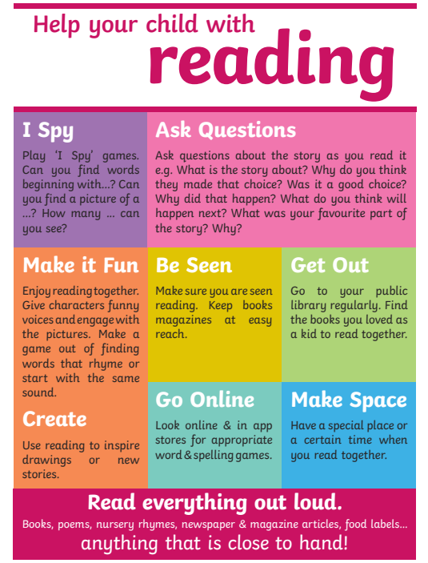
Reading
Children can change their reading books everyday
Record when you have read together in the Reading Record
Try to read everyday
Find quiet, stress free times to read
Ask questions to check understanding
Find different ways to encourage reading

Slide 10
Maths
We use the Hamilton Trust Scheme.
Place Value Addition and Subtraction Measures/lengths Time Fractions and Multiplication | Place Value and Number Addition and Subtraction Money and Time Measures/Weight and Data Multiplication Fractions 2D/3DShape/Symmetry | Place Value and Fractions Addition and Subtraction Multiplication and Division Position and Time Place Value and Addition Subtraction using Money Doubling/Halving Shape, Time and Data
Notes:
We use the Hamilton Trust Scheme for maths.
The Maths policies and links to the scheme are on the school’s webpage.
Maths sessions take place everyday and start with a maths fluency and mental arithmetic session.
Maths is taught through short units that are repeated throughout the year.

Slide 11
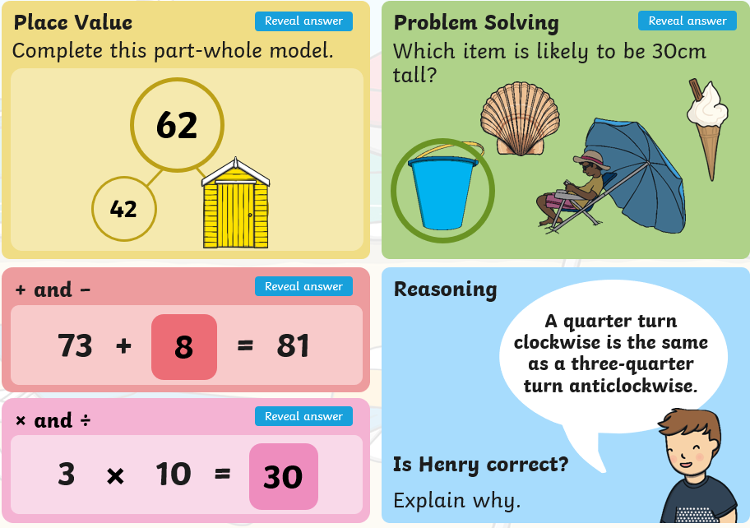

Slide 12
Topics
Animals | Staying Healthy | Traditional Tales | Celebrations | Growing things | People who help us

Slide 13
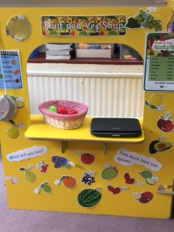
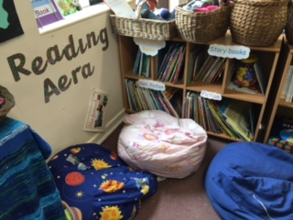
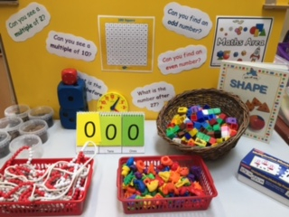
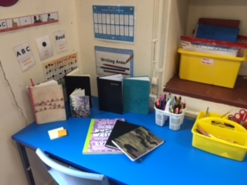
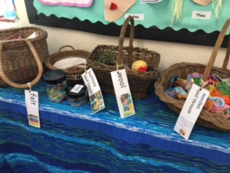
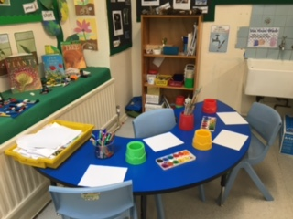
Our Learning Environment
Inside…..

Slide 14
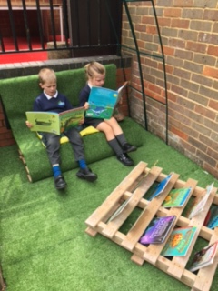
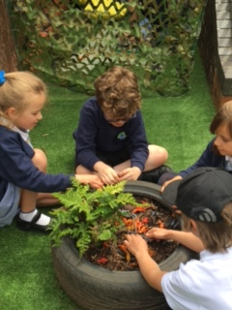
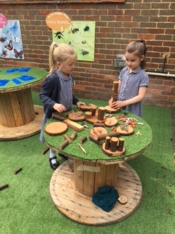
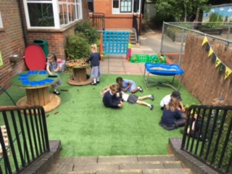
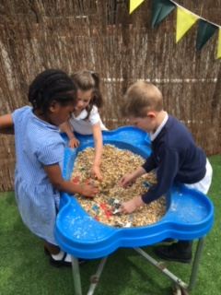
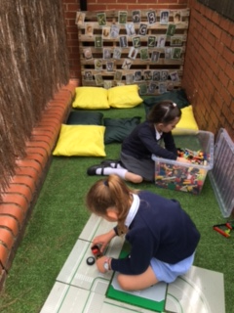
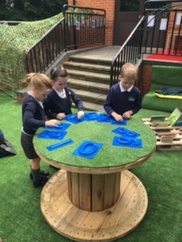
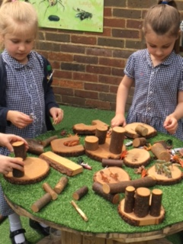
Outside…….

Slide 15
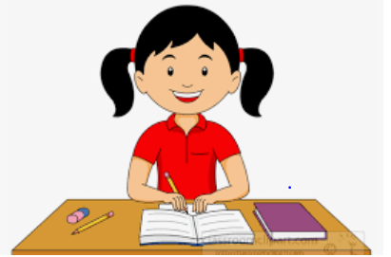
Homework
Spelling Homework
Topic Homework
Handed out each Friday.
To be returned any day throughout the week.

Slide 16
What do they need?
PE Kits
Forest school kit
Water bottles
Healthy Snack
Labelled clothes
No jewellery
Items for different weathers; coats, hats, etc.
Hair tied back

Slide 17
How can you help…
Create a stress free morning
Arrive to school on time
Read with them every day
Support them with homework
Communicate wit staff members
Make sure they get enough sleep

Slide 18
Communication
Termly Newsletter
Class Webpage
Email office
Phone or email office before 9am if your child is unable to attend school

Slide 19
Questions

